Slide 1




Real-Life Experience
Building a chatbot
on Azure Functions
Matti Petrelius
@mattipet

Slide 2


I Thought Chatbots were so 2016 or something...

Slide 3

hi! Bot Backend API Scale like crazy! Low Latency!
...you can make us an MVP, right?

Slide 4

serverless

Slide 5



Azure Functions
Blob+Queue
Storage
CosmosdB

Slide 6
BOT Framework

Slide 7


Azure Functions
v1
v2
❌ Node.js 6
❌ Windows only
Cold start 2 – 6 secs
✔ Node.js 8 and 10
✔ Cross-platform
Cold start 5 – 10 secs

Slide 8
MULTIPLE Function apps
aka Microservices
2 sec
2 sec
2 sec
= 6 sec

Slide 9
SINGLE Function APP
aka The Monolith

Slide 10

ASYNChrONOUS Functions
HTTP

Slide 11

No BIG SDKS
Node.js app size affects cold start
documentdb 2.04 MB
azure-storage 8.27 MB
unnamed bot sdk 81.89 MB

Slide 12
COSMOSDB MAnual Scaling
Throughput (400 – 10,000 RU/s)
400
Estimated spend (USD): $0.032 hourly / $0.77 daily.

Slide 13




Slide 14
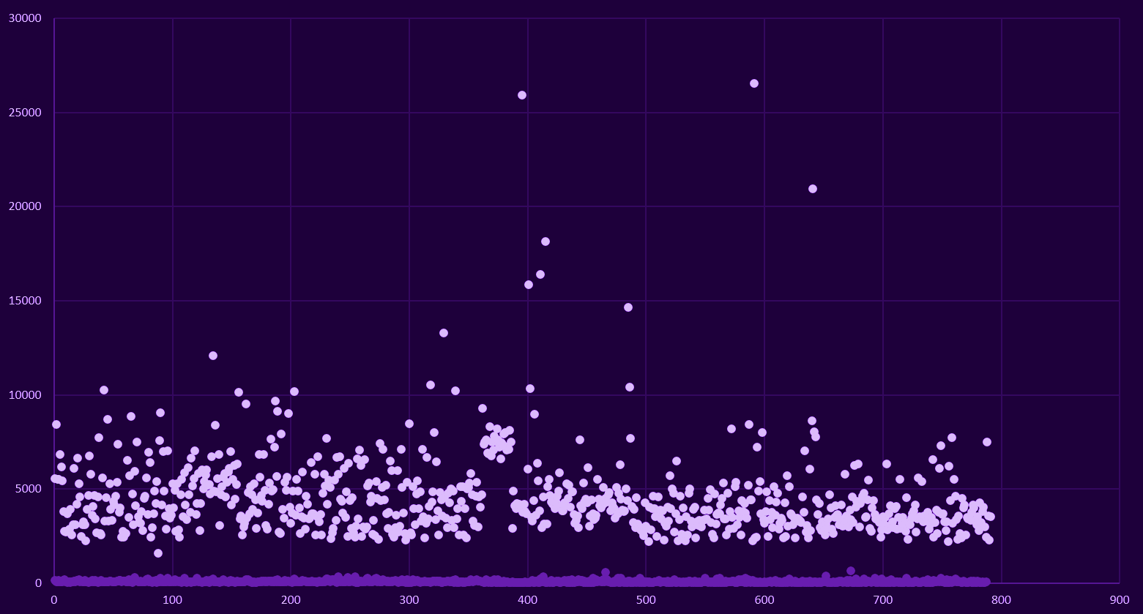
Azure FUnctions cold vs warm start
cold start
warm start

Slide 15

Timeout of 5 secs!!!
by the way, our web client requests have a

Slide 16
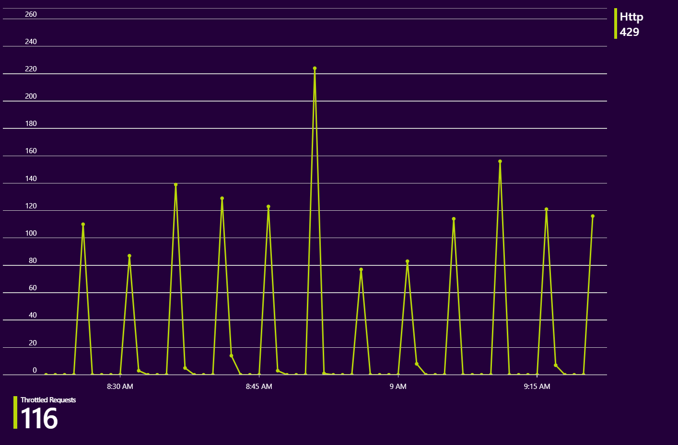
Number of requests exceeded capacity

Slide 17
Throughput (400 – 10,000 RU/s)
400
Estimated spend (USD): $0.032 hourly / $0.77 daily.

Slide 18
Throughput (400 – 10,000 RU/s)
800
Estimated spend (USD): $0.064 hourly / $1.54 daily.

Slide 19
Throughput (400 – 10,000 RU/s)
2000
Estimated spend (USD): $0.16 hourly / $3.84 daily.

Slide 20

Throughput (400 – 10,000 RU/s)
4000
Estimated spend (USD): $0.32 hourly / $7.68 daily.
= $230.40 monthly

Slide 21

Run- From- Package
Cold-start without:
10 – 20 sec
Cold-start with: 2 – 6 sec
WEBSITE_RUN_FROM_PACKAGE
https://mystor.blob.core.windows.net/deps/pack.zip
WEBSITE_RUN_FROM_PACKAGE
1

Slide 22

Disable App Insights ?
One second faster cold-start
... but is it worth more than monitoring?

Slide 23



Azure Functions Premium Plan
Pre-warmed instances for reduced cold start
Significantly more expensive than consumption plan
Now in public preview!

Slide 24


Local development and Debugging

Slide 25
Local development and Debugging
Visual Studio Code

Slide 26

CosmosDB Done Right
Automated scaling with SDK
Polling vs Event Based
Optimizing queries

Slide 27


Running in Production

Slide 28

MY TODOS
Evaluate Azure Functions Premium Plan
Remove polling CosmosDB queries
Convert to TypeScript
CI/CD
Improve monitoring

Slide 29

Thanks ya’ll !
Follow me on Twitter for more: @mattipet
Check out my blog: https://lesscodeismore.tech
pictures from freepik.com

